Slide 1
US vs. UK
STUDENT NEWSPAPER
Ashley + Ziyad

Slide 2
Table of contents
Potential RQs
Importance
Proposed
research questions
Education, Journalism,
NLP
Data
Expected Result
Data
& Data Collection
Proposed hypothesis
corresponding to RQs

Slide 3

Potential Research Questions
RQ1: Comparative Analysis of 2 Education Systems
How does a liberal arts education affect the writing practices of college newspaper journalists, compared to those who do not receive a liberal arts education?
RQ2: Convergence of ToI in longitudinal data
How has the rise of social media impacted the writing practices and topics of interest among student journalists in both the US and UK?
Are there any noticeable convergences or divergences in the interests of student journalists in the two countries?

Slide 4

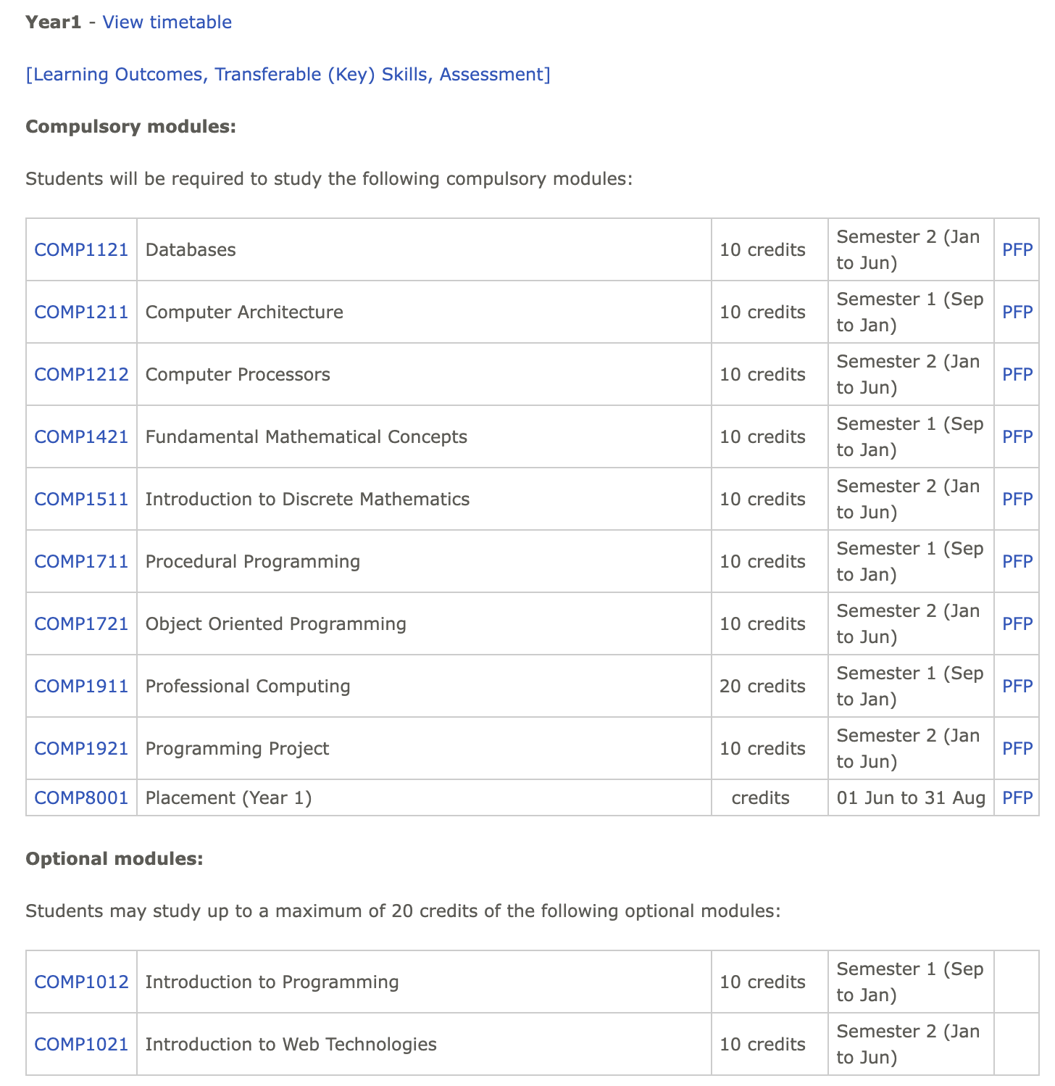
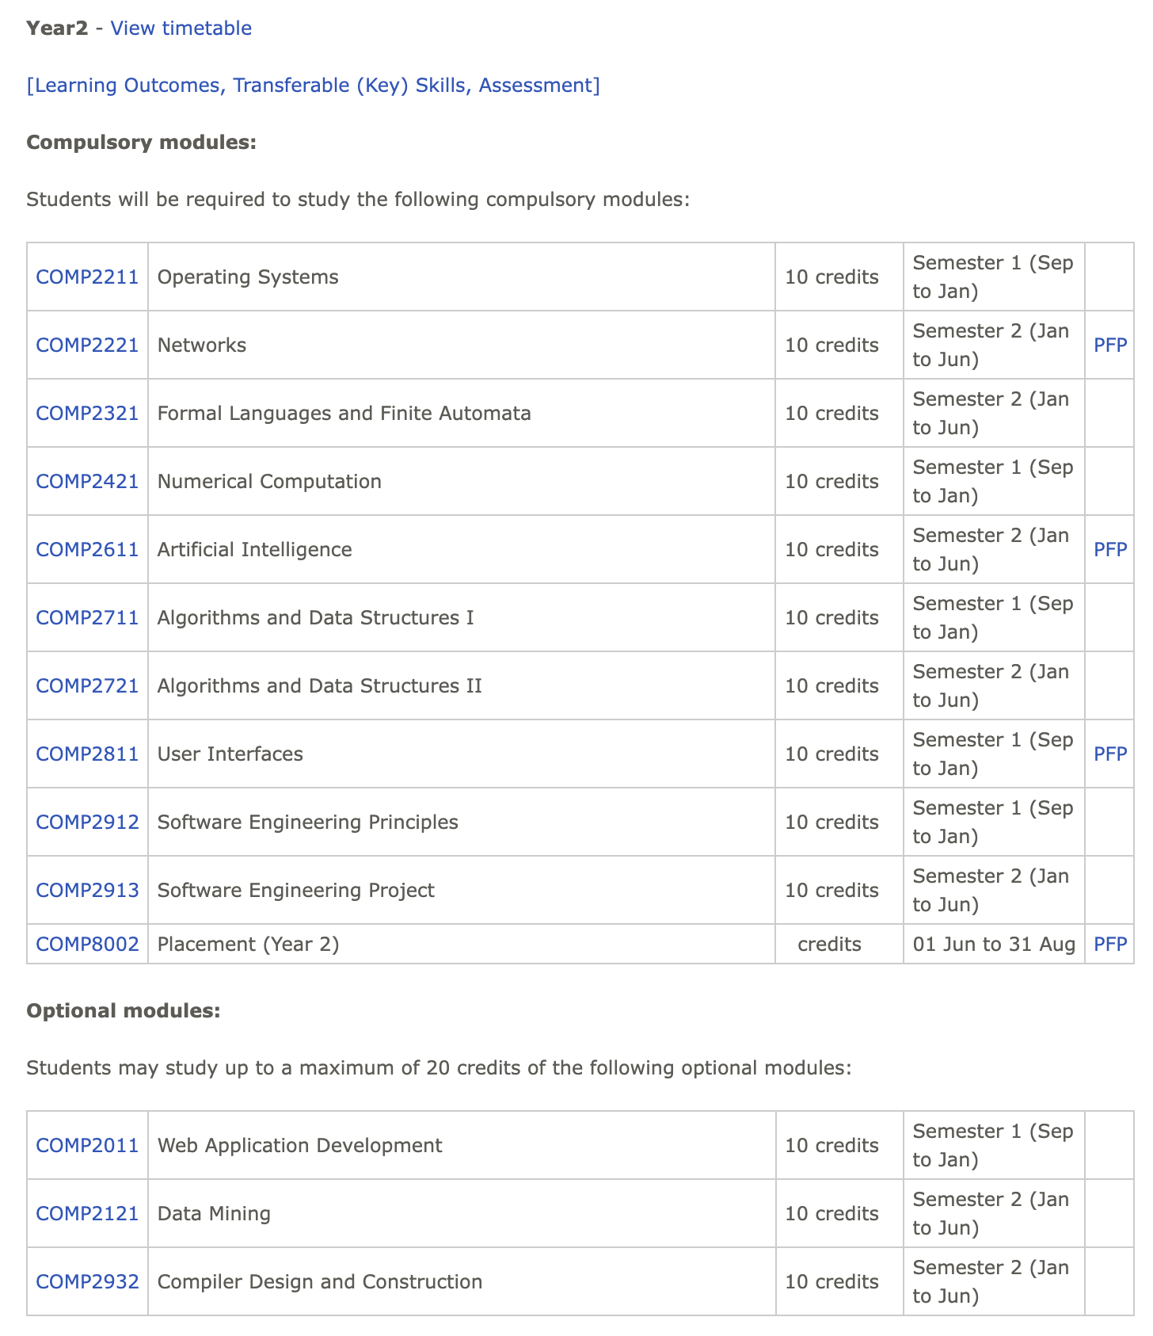
Importance
US Undergraduate Education System
UK Undergraduate Education System
Liberal Arts Education
a well-rounded foundation for future careers or graduate studies
Specialized University System
more focused and targeted towards specific career paths

Slide 5
Importance
 | Paper | Their conclusion | Implication in our research
Social Science Insights | Focusing in on employability: using content analysis to explore the employability discourse in UK and USA universities (2017) | Discourse around employability in UK and US universities through content analysis of their respective websites. In the UK, the focus is on government policies and targeted preparation for employment, while in the US, the discourse centers on institutional vision and social inclusion. | More well-prepared in the future of work (digitization, AI trend..) shown through writing quality?
 | Do Liberal Arts Colleges Really Foster Good Practices in Undergraduate Education? (2004) | Liberal arts colleges evidenced stronger positive impacts on a broad range of empirically vetted good practices in undergraduate education Active Learning: academic effort/involvement, computer use; High Expectations: scholarly/intellectual emphasis, number of written reports; | Clear and concise writing, Proper grammar and sentence structure?
 | An examination of how student journalists seek information and evaluate online sources during the newsgathering process | While journalism students exhibit some level of understanding about the importance of verification, they rely strongly on search engines and trust the credibility of search-engine results. | Better critical reading skill?
NLP | Linguistic features in writing quality and development: An overview | How language features found in text can predict human judgements of writing proficiency and changes in writing levels in both cross-sectional and longitudinal studies The paper focuses on three main linguistic constructs (lexical sophistication, syntactic complexity, and text cohesion) and their interactions with quality and growth | Use these features in our analysis

Slide 6
Data (1/2)
Data Collection
Sources
Curation
Scraping
Cleaning
Collected a list of top 20 best universities in the UK and in the UK according to QS World University Rankings
Curated newspapers with the most complete collections for 1940s-2020s either in archives or on the official website
Scraped the data from official archives and websites using Beautiful Soup and “Web Scraper” Chrome Extension
Cleaned our data

Slide 7
Data (2/2)
Data Summary
1940s
1950s
1960s
1970s
1980s
1990s
2000s
2010s
2020s
Yale
1940s
1950s
1960s
1970s
1980s
1990s
2000s
2010s
2020s
US
Harvard
1940s
1950s
1960s
1970s
1980s
1990s
2000s
2010s
2020s
Princeton
1940s
1950s
1960s
1970s
1980s
1990s
2000s
2010s
2020s
Leeds
1940s
1950s
1960s
1970s
1980s
1990s
2000s
2010s
2020s
UK
Newcastle
Archive Data
1940s
1950s
1960s
1970s
1980s
1990s
2000s
2010s
2020s
Website Data
ICL
N/A

Slide 8
Expected Results
RQ1: Comparative Analysis of 2 Education Systems
Students with liberal arts education are expected to have better writing quality and practices.
RQ2: Convergence of ToI in longitudinal data
More diverse topic of interests after the rise of social media
Potential convergences in articles with topics related to entertainment and divergences in politics-related articles.

Slide 9
THANKS

Slide 10
Data (3/3)
Preliminary Analysis
Topics
Most common words
US
Topics
Most common words
UK

Slide 13
Our services
Basic
Pro
Premium
$35
You can explain your product or your service
Characteristic
Characteristic
$60
You can explain your product or your service
Characteristic
Characteristic
$85
You can explain your product or your service
Characteristic
Characteristic

Slide 14
Our services
Free
Basic
Pro
Premium
You can explain here your product or your service
Characteristic
Characteristic
Characteristic
You can explain here your product or your service
Characteristic
Characteristic
Characteristic
You can explain here your product or your service
Characteristic
Characteristic
Characteristic
You can explain here your product or your service
Characteristic
Characteristic
Characteristic
$0
$35
$50
$100

Slide 15
Learning icon pack

Slide 16
Alternative resources

Slide 17
Alternative infographic elements

Slide 18
Alternative resources

